Slide 1
Functions 2

Slide 2
Functions Calling Other Functions
Function can call another function
When the called function terminates
Control returns to the place in calling function just after where function call occurred.
Example 1 : Function firstPart calls the function secondPart.

Slide 3
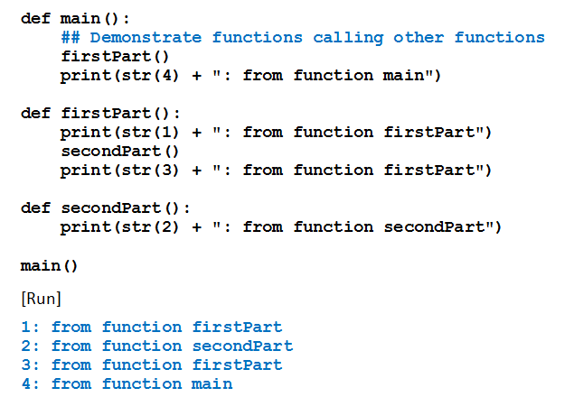
Functions Calling Other Functions
Example 1

Slide 4
Functions Returning Multiple Values
Functions can return any type of object
Function can return a tuple.
Example 2: balanceAndInterest function returns a tuple
Giving values associated with deposit into savings account.

Slide 5
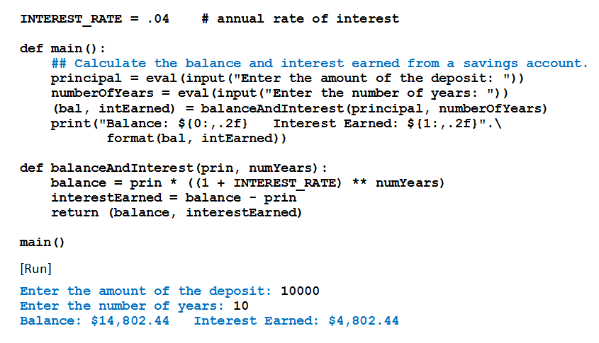
Functions Returning Multiple Values
Example 2

Slide 6
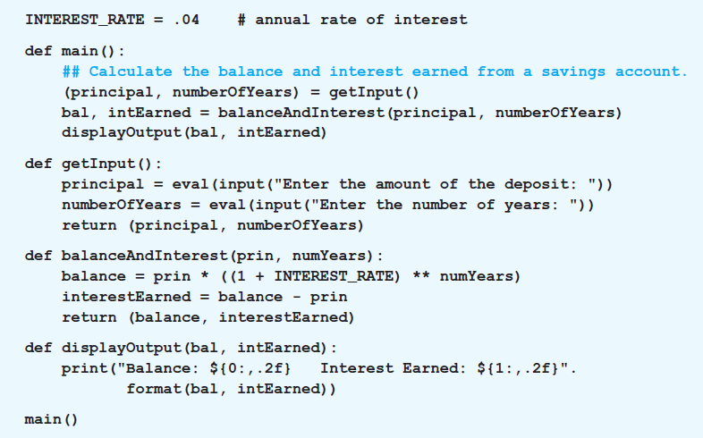
Functions Returning Multiple Values
Example 3: Variation of Example 2 has the input, processing, and output performed individually by three functions.

Slide 7


List Comprehension
Simpler way to apply a certain function to each item of a list
Use list comprehension
The for clause in a list comprehension can optionally be followed by an if clause.

Slide 8
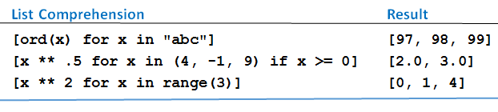
List Comprehension
Table 4.3 Examples of list comprehension.

Slide 9
Default Values
Parameters of a function can have default values
Assigned to them when no values are passed to them
Format for definition using default values

Slide 10

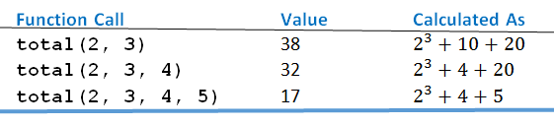
Default Values
Table 4.4 Three function calls

Slide 11
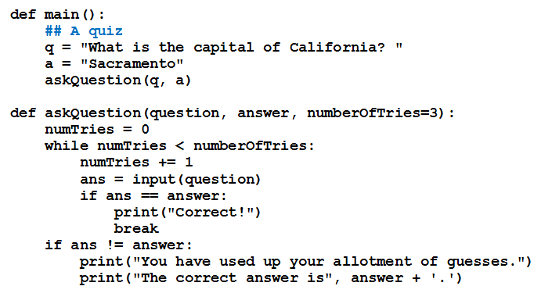
Default Values
Example 4: Program gives user three tries to answer question

Slide 12


Passing by Parameter Name
Arguments can be passed to functions by using names of the corresponding parameters
Instead of relying on position
Given
Could use

Slide 13
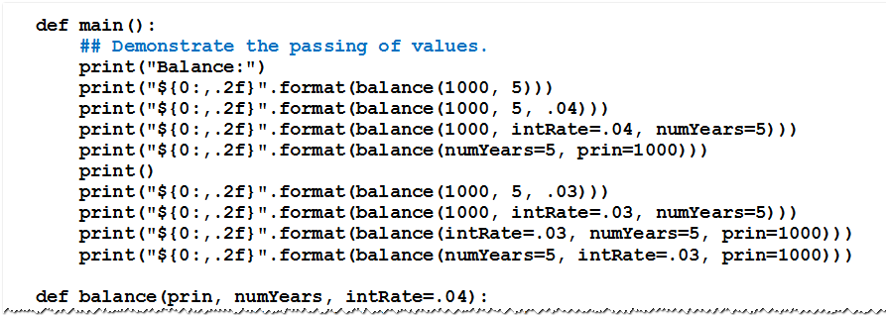
Passing by Parameter Name
Example 5: Several ways to pass values

Slide 14
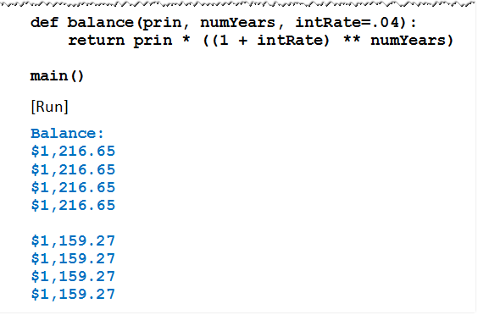
Passing by Parameter Name
Example 5: Several ways to pass values

Slide 15
Custom Sorting
Functions can be used to order the items by any criteria we choose
With a list of strings, we can sort them by
Length
Last characters
Number of vowels
… by many other properties

Slide 16
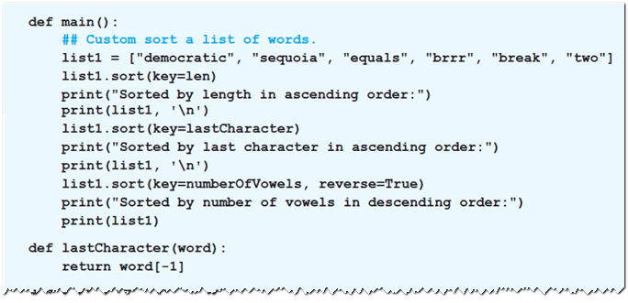
Custom Sorting
Example 6: Program sorts list of words using each of three properties mentioned above

Slide 17
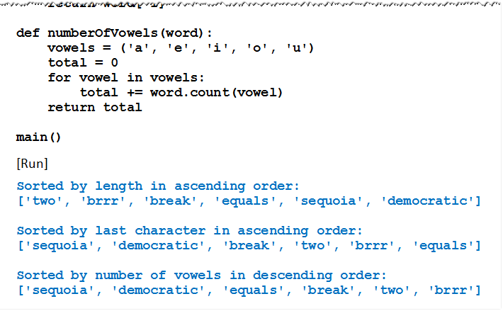
Custom Sorting
Example 6: Program sorts list of words using each of three properties mentioned above

Slide 18
Lambda Expressions
One-line mini-functions
Can be used where a simple function is required.
Compute a single expression
Cannot be used as a replacement for complex functions
Format
Where expression is the value to be returned

Slide 19
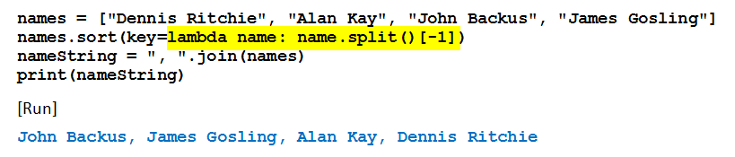
Lambda Expressions
Example 7: Function sorts names by their surnames
Lambda function highlighted

Slide 20

The sorted Function
Contrast with sort function
sort function alters order of items in a list
sorted function returns a new ordered list
Both can make use of the optional arguments key and reverse.
sorted function also can be used with lists, strings, and tuples

Slide 21
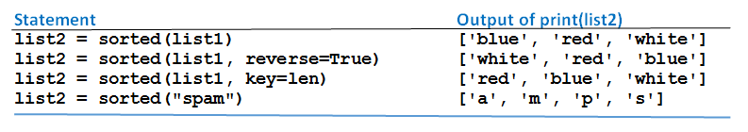
The sorted Function
Table 4.5 Values produced by sorted function (list1 = ["white", "blue", "red"])

Slide 22
END

